Slide 1
Reproducible Research: Sharing Data and Code

Slide 2
Why Git?
Track/Rollback changes
Use different branches
Share code and data
Track issues
Integrated in RStudio (and others, e.g. Eclipse)

Slide 3
Git services (Free)

Slide 4
Git services (Paid)

Slide 5
Git services – Current options
GitHub.com (Personal + Group)
Bitbucket.com (Personal(s))
gitlab.curie.fr (Only Inside Curie NET)

Slide 6
Code and results with notebooks
Notebooks can be used to mix code and results (including intercative plots)
They are available via jupyter (http://jupyter.org) and support many languages
The easiest way to get Jupyter is via the Anaconta python distribution
RStudio offers similar solutions for R via Markdown documents

Slide 7
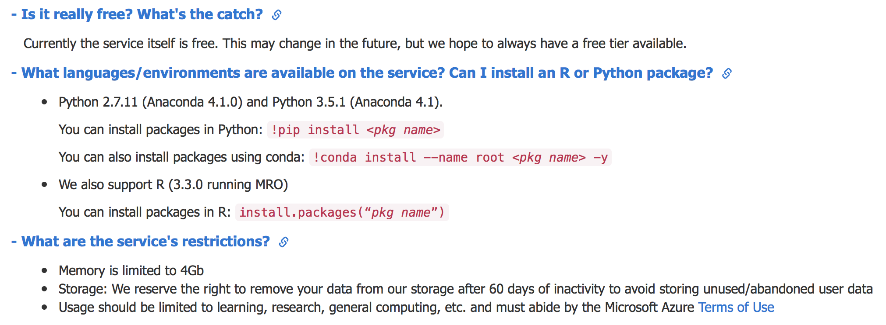
Microsoft Azure (notebooks.azure.com)
+ F# & Python 3.6

Slide 8
Google Colaboratory (colab.research.google.com)
Supports Python 2 and 3
2-core Xeon 2.2GHz
13GB RAM
33GB HDD
maximum lifetime of a VM is 12 hours
Idle VMs time out after 90m
Has limited GPU computing

